Slide 1
24
7
30
Date
Index Laws – Mini lesson 2
EQ – How to use Negative Index Law
What terminology will I expect to see when using Index Laws
Terminology –
Base
Index, Indices, Power, Exponent
Index Form, Power Form, Index Notation
Extended Form, Expanded Form, Factor Form
In the questions –
Expand
Simplify
Find, Solve, Evaluate, Calculate, Express
Positive indicies
1
Notes:
Lesson objective (EQ)

Slide 2
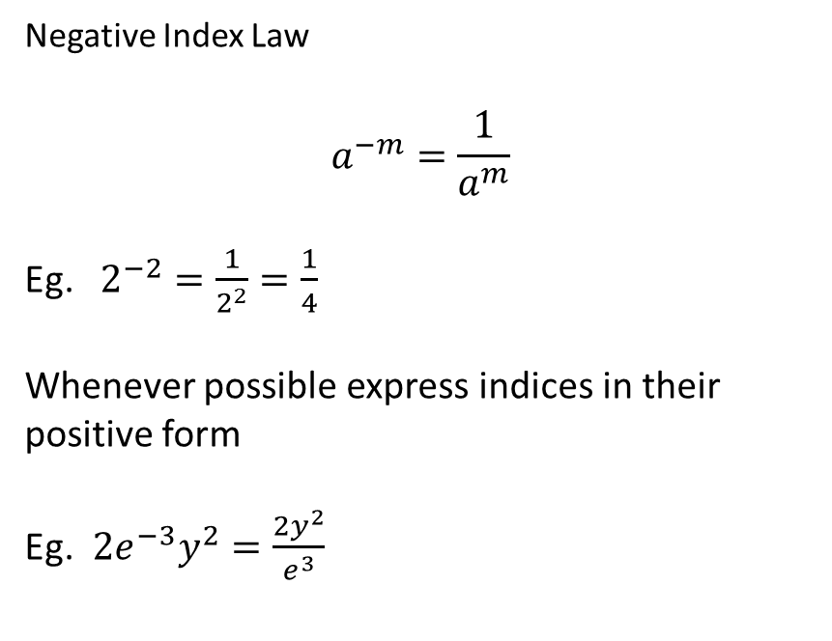
24
7
30
Date
Index Laws – Mini lesson 2
EQ – How to use Negative Index Law
What the negative index law
Negative Index Law
$$a^{−m}=\frac{1}{a^{m}}$$
Eg. $2^{−2}=\frac{1}{2^{2}}=\frac{1}{4}$
Whenever possible express indices in their positive form
Eg. $2e^{−3}y^{2}=\frac{2y^{2}}{e^{3}}$
2
Notes:
Input

Slide 3
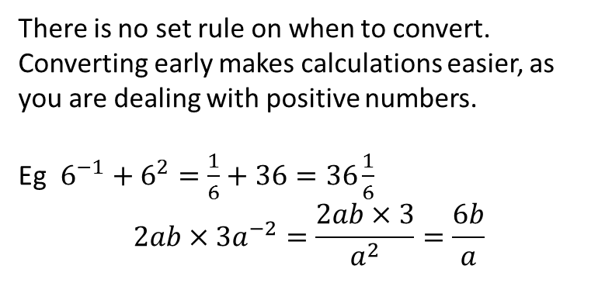
24
7
30
Date
Index Laws – Mini lesson 2
EQ – How to use Negative Index Law
At what point do you convert negative indices to positive indices.
There is no set rule on when to convert. Converting early makes calculations easier, as you are dealing with positive numbers.
Eg $6^{−1}+6^{2}=\frac{1}{6}+36=36\frac{1}{6}$
$$2ab×3a^{−2}=\frac{2ab×3}{a^{2}}=\frac{6b}{a}$$
3
Notes:
Input

Slide 4
Activity
Nelson – Page 13 & 14
Q10
Q13 f, g, l
Q20 b, e, g,
Notes:
Independent practice

Slide 5
Closure activity
Thumbs up
Notes:
Closure

